Slide 1







Slide 2
Learning Outcomes
I can participate in new opportunities and experiences​
I can speak in a group and share my opinions​
I can listen to other people's opinions​
I can work with others on group tasks​
I can participate in decision making processes​
I can explain why I made a choice​
I can take action on issues that are important to me​
I can influence decision-making​
Notes:
I can participate in new opportunities and experiences
I can speak in a group and share my opinions
I can listen to other people's opinions
I can work with others on group tasks
I can participate in decision making processes
I can explain why I made a choice
I can take action on issues that are important to me
I can influence decision-making

Slide 3
The Scottish Youth Parliament is the democratically elected voice of Scotland’s young people

Slide 4
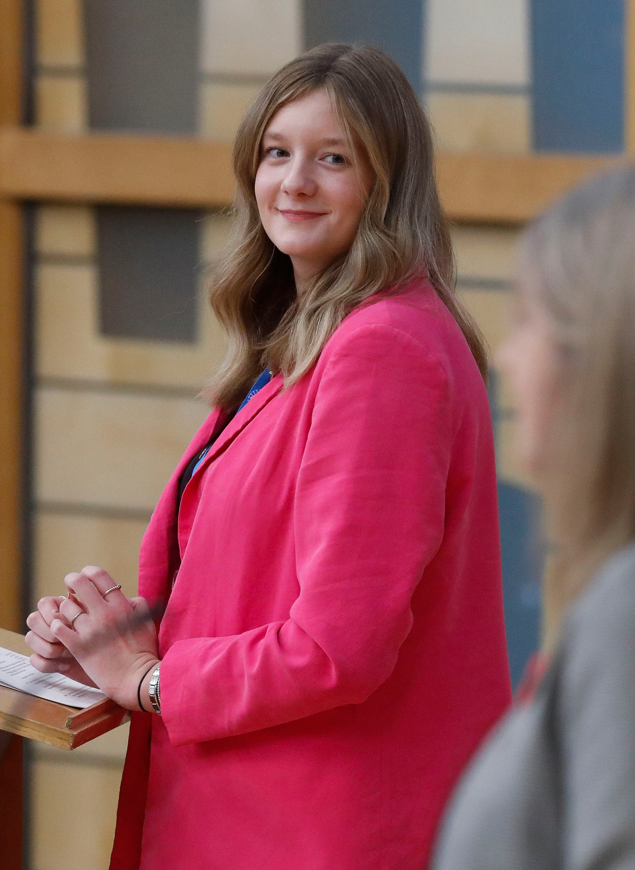
About SYP
  SYP is youth-led. Young people decide how we run.
  The Youth Parliament is one day older than the main Scottish Parliament.
  There are over 160 Members of the Scottish Youth Parliament (MSYPs).
  We want to make Scotland the best place in the world to grow up.
  MSYPs have made change for young people like free bus travel.
SYP Chair Ellie Craig MSYP alongside Alison Johnstone, Presiding Officer of the Scottish Parliament, chairing a MSYP debate in Parliament in November 2024

Slide 5

What is a manifesto?
  Every five years SYP create a manifesto. This is a document with a list of ideas which young people think decision makers need to do.
  Young people choose all the ideas in the manifesto.
  SYP will use the ideas chosen by young people to plan our work until 2031.
  The new manifesto will be published in August 2025.
  MSYPs will use it to ask political parties to include their ideas in their plans.

Slide 6
How did SYP get to this stage?
1
2
3
We looked at information about issues young people care about. We asked young people if they still cared about these issues.
The Conveners Group, a group of MSYPs who focus on policy, chose 31 ideas to ask young people about.
This list of issues was then given to MSYPs to review before writing policy ideas.

Slide 7


Your information
How Scottish Youth Parliament will protect and uses the information
you give us.
How this works
Further details
We will record information about this session, like the number of people who 'agree' or 'disagree' with each policy idea.
We might write down something you say about why you agree or disagree. This will not have your name on it. No one will know you said it.
We will use the information from all sessions in the manifesto to tell others what young people think.
You can find out more at
syp.org.uk/privacy-policy.
There's more information about taking part in the manifesto consultation. Scan the QR code to read it.

Slide 8
Policy
Education
Services
Sustainability
Social Justice
Rights
There are 5 key themes.

Slide 9
Support for Young People
  Childline www.childline.org.uk
  0800 1111 (freephone 24/7)
  Beat (info and support on eating disorders) www.beateatingdisorders.org.uk
  0808 801 0432 (Mon – Fri 9am to midnight & Sat – Sun 4pm to midnight)
  Breathing Space (Scotland) www.breathingspace.scot
  0800 83 85 87 (Freephone Mon –Thurs 6pm to 2am and from Fri 6pm to Mon 6am)
  Papyrus Hopeline UK www.papyrus-uk.org/help-advice
  0800 068 4141 (freephone) Text: 07860039967
  Samaritans www.samaritans.org
  116 123 (Freephone 24/7)
  The Mix www.themix.org.uk/get-support/speak-to-our-team/email-us
  0808 808 4994 (4pm –11pm)

Slide 10

Education
Policy #1
What do young people think about the future of education, youth work, learning and access to educational institutions within Scotland?
The Scottish Government needs to change what and how we learn in school, by listening to young people.

Slide 11
Education
Policy #2
What do young people think about the future of education, youth work, learning and access to educational institutions within Scotland?
All young people in Scotland should be able to learn about how to manage their money.

Slide 12
Education
Policy #3
What do young people think about the future of education, youth work, learning and access to educational institutions within Scotland?
Young people should be able to go to college or university without challenges like money or housing.

Slide 13
Education
Policy #4
What do young people think about the future of education, youth work, learning and access to educational institutions within Scotland?
Young people with additional support needs in Scotland are not getting the support they need. The Scottish Government and local councils need to make sure there are services in schools and other education settings.

Slide 14
Education
Policy #5
What do young people think about the future of education, youth work, learning and access to educational institutions within Scotland?
The Scottish Government and local councils must work together to fund youth work services for young people.

Slide 15
Education
Policy #6
What do young people think about the future of education, youth work, learning and access to educational institutions within Scotland?
Local councils need to make spaces for young people in local communities, where young people can hang out and spend time together.

Slide 16

Services
Policy #1
What do young people think about the future of the public services, housing and support available and accessible to young people in Scotland?
The NHS should be free for all people in Scotland.

Slide 17
Services
Policy #2
What do young people think about the future of the public services, housing and support available and accessible to young people in Scotland?
There should be support for young people's mental health in schools and in the community.

Slide 18
Services
Policy #3
What do young people think about the future of the public services, housing and support available and accessible to young people in Scotland?
The Scottish Government should make sports and leisure services more accessible and affordable for young people, especially in rural and more deprived areas.

Slide 19
Services
Policy #4
What do young people think about the future of the public services, housing and support available and accessible to young people in Scotland?
Every young person in Scotland should have access to fast and reliable internet and devices to access the digital world, no matter where they live or how much money their family has.

Slide 20
Services
Policy #5
Every young person in Scotland should have accessible, affordable and secure housing. The Scottish Government should make sure housing is fit for what local communities need.
What do young people think about the future of the public services, housing and support available and accessible to young people in Scotland?

Slide 21
Services
Policy #6
What do young people think about the future of the public services, housing and support available and accessible to young people in Scotland?
The Scottish Government should make stronger laws that control how much landlords can charge young people for rent.

Slide 22

Sustainability
Policy #1
The Scottish Government should take bold and urgent action to tackle the climate crisis.
What do young people think about Scotland's environment now and in the future?

Slide 23
Sustainability
Policy #2
What do young people think about Scotland's environment now and in the future?
Free Bus Travel should be expanded to include all young people (up to their 26th birthday) and across all forms of public transport, like trains, trams and ferries.

Slide 24
Sustainability
Policy #3
What do young people think about Scotland's environment now and in the future?
Public transport should be accessible and reliable for young people across Scotland, particularly those living in rural areas.

Slide 25
Sustainability
Policy #4
What do young people think about Scotland's environment now and in the future?
The Scottish Government should create more nature reserves to help protect Scotland’s nature and biodiversity.

Slide 26
Sustainability
Policy #5
What do young people think about Scotland's environment now and in the future?
The Scottish Government should work with young people to promote a circular economy.
A circular economy is a way of using resources that doesn't harm the environment by recycling and reusing things that already exist.

Slide 27

Social Justice
Policy #1
What do young people think about making Scotland fair for everyone with opportunities for all?
Harming another person because of their gender should be illegal in Scotland.

Slide 28
Social Justice
Policy #2
What do young people think about making Scotland fair for everyone with opportunities for all?
People who report sexual assault shouldn’t have to wait a long time for justice. The time between telling the police and going to court should be shorter.

Slide 29
Social Justice
Policy #3
Children and young people going through the justice system should be supported in a 'Bairn's Hoose'.
A Bairn's Hoose is for children and young people who have been through difficult experiences. They can get help and support all in one place, with friendly people who understand what they're going through, so they don't have to go to lots of different places to talk about what happened to them
What do young people think about making Scotland fair for everyone with opportunities for all?

Slide 30
Social Justice
Policy #4
What do young people think about making Scotland fair for everyone with opportunities for all?
People who have periods should get paid menstrual leave.
Menstrual leave means a person can take time off work when period symptoms make it difficult to do their work.

Slide 31
Social Justice
Policy #5
What do young people think about making Scotland fair for everyone with opportunities for all?
Employers should make sure people who do the same work get paid the same no matter their gender.

Slide 32
Social Justice
Policy #6
What do young people think about making Scotland fair for everyone with opportunities for all?
Young people in Scotland should have the opportunity to live, work, and study in other countries.

Slide 33
Social Justice
Policy #7
What do young people think about making Scotland fair for everyone with opportunities for all?
All children and young people in Scotland should have free school meals.

Slide 34

Rights
Policy #1
The Scottish Government must enshrine a right to independent advocacy for Care Experienced people of all ages.
Independent advocacy helps people make decisions about what's happening to them and support them to have their rights respected.
What do young people think about the future of Human Rights in Scotland?

Slide 35
Rights
Policy #2
What do young people think about the future of Human Rights in Scotland?
All over 16’s living in the UK should have the right to vote in all UK elections.

Slide 36
Rights
Policy #3
Trans young people have a right to good quality gender-affirming care and this care should be accessible and available, wherever the young person lives.
Gender-affirming care is a combination of social, legal, and medical support that help people feel safe, healthy, and happy in their gender.
What do young people think about the future of Human Rights in Scotland?

Slide 37
Rights
Policy #4
The Scottish Government should better protect the rights of disabled people , Black and ethnic minority people, women’ and LGBTQ+ people. They should do this through the law.
What do young people think about the future of Human Rights in Scotland?

Slide 38
Rights
Policy #5
What do young people think about the future of Human Rights in Scotland?
The Scottish Government and other decision makers must respect the views of children and young people in all decisions that affect them.

Slide 39
Rights
Policy #6
What do young people think about the future of Human Rights in Scotland?
The Scottish Government should address prejudice, discrimination and bullying experienced by children and young people.

Slide 40
Rights
Policy #7
What do young people think about the future of Human Rights in Scotland?
The UK Government must ensure that all refugee and asylum-seeking children and young people have a right to be with their families in the UK.

Slide 41
Full survey
You can also share your opinions on all the policy ideas in our survey.
You can add more information for each theme.
Scan the QR code or go to the web address to complete the full survey.
bit.ly/SYPManifesto26

Slide 42


Rewards
Thank you for sharing your opinions with us!
To say thanks, YoungScot are giving young people 150 Rewards points.
You can scan the QR code to add them to your account or enter the code XXJUJFIE at membership.young.scot.
SYP will also be offering a prize for schools and youth groups that take part.

Slide 43

Thank you
Thank you for sharing your views with the Scottish Youth Parliament today.
The information you have shared today will be used to help decide which policies are included in the manifesto.
You can find out more about what we do at syp.org.uk or on social media @OfficialSYP.

