Slide 1







Slide 2
Learning Outcomes
By the end of today, you will have learned how to:
Theme | Curriculum for Excellence | Youth Work Framework
Develop your knowledge | Explore and express their rights (HWS 3-09, 4-09) Develop their knowledge of political decision-making in Scotland (SOC-3-18, 4-18) | Participate safely and effectively in groups and teams (O4) Broaden their perspectives through new experiences and thinking (O7)
Contribute your views | Discuss and take a view on current social, political and economic issues (SOC 3-15) Discuss actions that decision-makers should take to meet the needs of Scotland's young people (SOC 4-16) | Create and apply their learning (O3) Grow as active citizens, expressing their voice and enabling change (O6)
Create change | Contribute to bringing about change (HWB 3-13, 4-13) | Grow as active citizens, expressing their voice and enabling change (O6)

Slide 3
The Scottish Youth Parliament is the democratically elected voice of Scotland’s young people

Slide 4
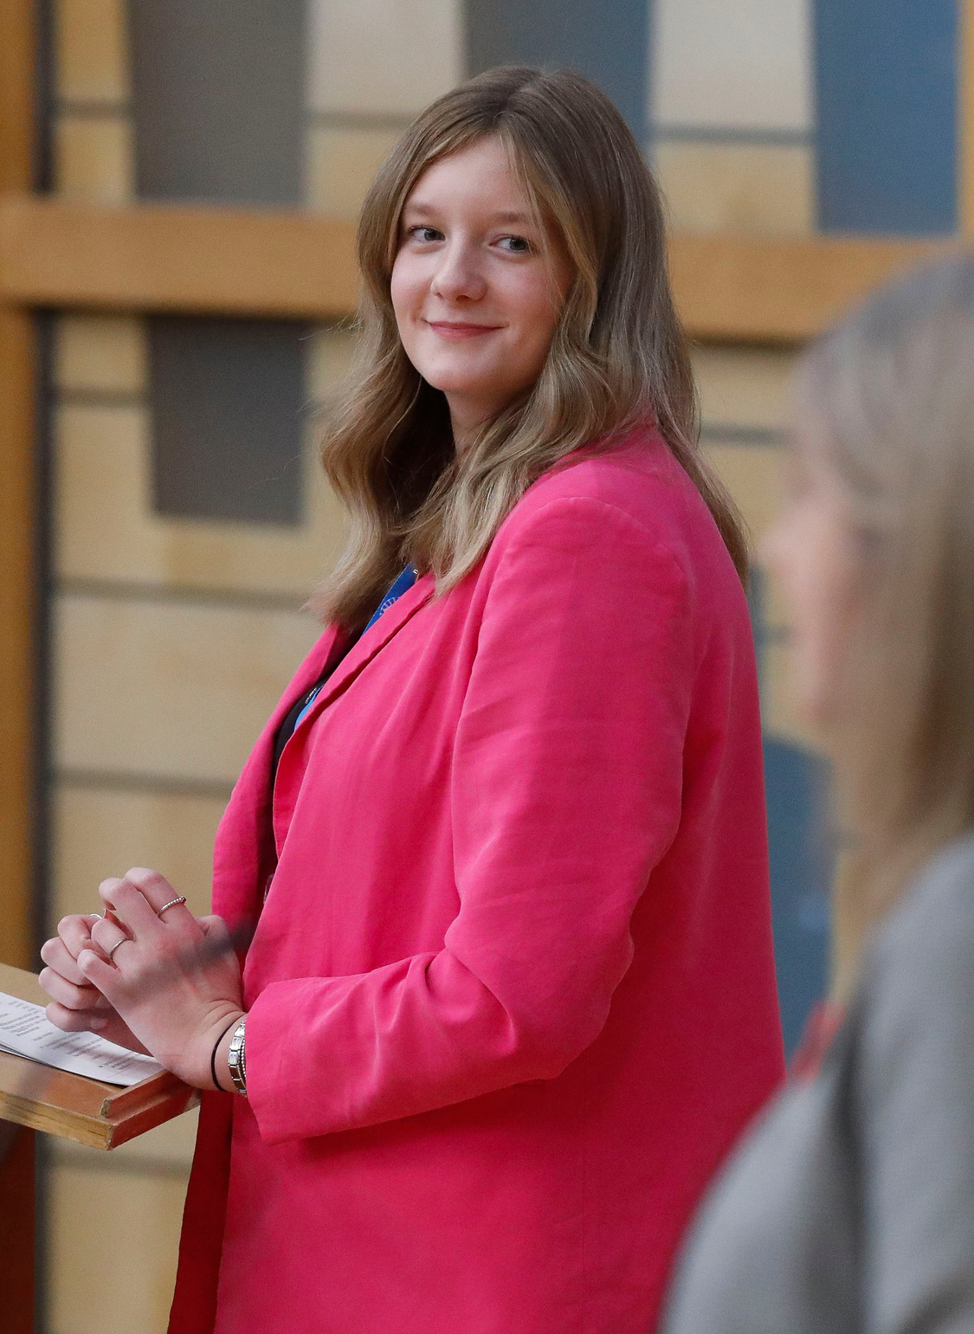
About SYP
  SYP is a uniquely youth-led charity, which means the organisation’s entire governance process is managed by young people
  The Youth Parliament is one day older than the main Scottish Parliament, having held our first Sitting on 30 June 1999
  There are over 160 Members of the Scottish Youth Parliament (MSYPs) and SYP’s vision is to make Scotland the best place in the world to grow up
  Members have led successful campaigns on equal marriage, votes at 16, free bus travel and the incorporation of the UNCRC
SYP Chair Ellie Craig MSYP alongside Alison Johnstone, Presiding Officer of the Scottish Parliament, chairing a MSYP debate in Parliament in November 2024

Slide 5

What is a manifesto?
  Since 2007, every five years, in line with the Scottish Parliament elections, SYP have created a manifesto, which is a document created by young people for young people
  In the document, SYP will include a list of ideas which young people think decision makers need to implement to meet the needs Scotland's young people
  Each of these ideas will be worded as a ‘policy’ which sets out young people’s views and calls to action on each issue
  SYP will use the issues highlighted to plan campaigns from 2026 until 2031
  The Youth Parliament’s new manifesto will be published later this year, ahead of the May 2026 Scottish Parliament election - MSYPs will use it to ask the political parties to include the policies in their plans

Slide 6
How did SYP get to this stage?
1
2
3
Last year, SYP completed analysis of existing research and held an initial consultation on issues that young people care about
The Conveners Group, which is SYP’s main policy and campaigning steering group, then finalised the policies to go out to consultation
This list of issues was then given to MSYPs to review before drafting policies

Slide 7


Your information
Here is some information about the views you will share with the
Scottish Youth Parliament as well as how SYP protects and uses your data.
How this works
Further details
Information from this session will be added into SYP’s manifesto consultation form.
The only information recorded will be the number of “agree”, “disagree” and “don’t know” responses to each policy.
Any quotes you want to give will be anonymised and analysed and may be used in SYP's 2026-2031 manifesto.
You can view SYP’s privacy policy at syp.org.uk/privacy-policy.
You can view a copy of
SYP’s manifesto
participant information
sheet by scanning this
QR code.

Slide 8
Slide | Policy
10 | Education
16 | Services
22 | Sustainability
27 | Social Justice
34 | Rights
SYP has grouped together the policies we are going to discuss under 5 key themes

Slide 9
Support for young people​
  Childline childline.org.uk​
    0800 1111 (freephone 24/7)​
  Beat (information and support on eating disorders) beateatingdisorders.org.uk​
    0808 801 0432 (Mon – Fri 9am to midnight & Sat – Sun 4pm to midnight)​
  Breathing Space (Scotland) breathingspace.scot
    0800 83 85 87 (Mon – Thurs 6pm to 2am and from Fri 6pm - Mon 6am)​
  Papyrus Hopeline UK papyrus-uk.org/help-and-advice
    Freephone: 0800 068 4141 Text: 07860039967​
  Samaritans samaritans.org​
    116 123 (Freephone 24/7)​
  The Mix themix.org.uk/get-support/speak-to-our-team/email-us​
    0808 808 4994 (4pm –11pm)​

Slide 10

Education
Policy #1
Through these policies, we want to understand young people’s views on the future of education, youth work, learning and access to educational institutions within Scotland.
The Scottish Government need to take urgent and radical action to reform the national curriculum and assessments in line with the views and needs of young people.

Slide 11
Education
Policy #2
Through these policies, we want to understand young people’s views on the future of education, youth work, learning and access to educational institutions within Scotland.
In order to support young people to have their views heard on matters relating to personal finance, tax and the economy, financial education should be available to all young people in Scotland.

Slide 12
Education
Policy #3
Through these policies, we want to understand young people’s views on the future of education, youth work, learning and access to educational institutions within Scotland.
Finances, housing, or a lack of support services should not be barriers to young people accessing further or higher education and decision-makers should work together to break down those barriers.

Slide 13
Education
Policy #4
Through these policies, we want to understand young people’s views on the future of education, youth work, learning and access to educational institutions within Scotland.
Young people with additional support needs in Scotland are not receiving the support they need and, therefore, the Scottish Government and Local Authorities should invest in services to support them in schools and other education settings.

Slide 14
Education
Policy #5
Through these policies, we want to understand young people’s views on the future of education, youth work, learning and access to educational institutions within Scotland.
The Scottish Government and Local Authorities must work together and commit to a secure and multi-year funding model for the youth work sector.

Slide 15
Education
Policy #6
Through these policies, we want to understand young people’s views on the future of education, youth work, learning and access to educational institutions within Scotland.
Local Authorities must provide youth-specific spaces in local communities, with investment put towards cultural, social and artistic activities where young people can gather and spend time together.

Slide 16

Services
Policy #1
Through these policies, we want to understand young people’s views on the future of the public services, housing and support available and accessible to young people in Scotland.
The NHS should be protected from privatisation and remain free at the point of need.

Slide 17
Services
Policy #2
Through these policies, we want to understand young people’s views on the future of the public services, housing and support available and accessible to young people in Scotland.
Prevention and early-intervention approaches, including education and community based mental health services, should be invested in to support young people’s mental health.

Slide 18
Services
Policy #3
Through these policies, we want to understand young people’s views on the future of the public services, housing and support available and accessible to young people in Scotland.
The Scottish Government should make sports and leisure services more accessible and affordable for young people, especially in rural and more deprived areas.

Slide 19
Services
Policy #4
Through these policies, we want to understand young people’s views on the future of the public services, housing and support available and accessible to young people in Scotland.
Every young person in Scotland should have access to fast and reliable internet and devices to access the digital world, regardless of their geographical location or financial situation.

Slide 20
Services
Policy #5
In order to ensure that every young person in Scotland has accessible, affordable and secure housing, the Scottish Government should invest in social housing and allocate funding to local authorities – particularly in rural and island communities - to ensure housing is fit for local need.
Through these policies, we want to understand young people’s views on the future of the public services, housing and support available and accessible to young people in Scotland.

Slide 21
Services
Policy #6
Through these policies, we want to understand young people’s views on the future of the public services, housing and support available and accessible to young people in Scotland.
The Scottish Government must strengthen rent controls for all young people, including students and apprentices, in Scotland and ensure that all young people are aware of their rights in relation to housing.

Slide 22

Sustainability
Policy #1
The climate emergency is an issue of climate justice and so it is essential that the Scottish Government takes bold and urgent action to meet ambitious targets to reduce greenhouse gas emissions and tackle the climate crisis.
Through these policies, we want to understand young people’s views on Scotland's sustainability now and in the future.

Slide 23
Sustainability
Policy #2
Through these policies, we want to understand young people’s views on Scotland's sustainability now and in the future.
The Scottish Government’s ‘Young Persons’ (Under 22s) Free Bus Travel Scheme’ should be maintained and expanded to include all young people (up to their 26th birthday) and across all forms of public transport.

Slide 24
Sustainability
Policy #3
Through these policies, we want to understand young people’s views on Scotland's sustainability now and in the future.
Transport Scotland and public transport companies should ensure that public transport services are accessible and reliable for young people across Scotland, particularly those living in rural areas.

Slide 25
Sustainability
Policy #4
Through these policies, we want to understand young people’s views on Scotland's sustainability now and in the future.
The Scottish Government should create more nature reserves to help protect Scotland’s nature and biodiversity.

Slide 26
Sustainability
Policy #5
Through these policies, we want to understand young people’s views on Scotland's sustainability now and in the future.
The Scottish Government should work with young people to promote a circular economy and ensure that businesses make improved progress towards reducing waste.

Slide 27

Social Justice
Policy #1
Through these policies, we want to understand young people’s views on the future of equity, accessibility and social mobility within Scotland.
To protect girls and young women from gender-based violence, misogyny should be a hate crime in Scotland.

Slide 28
Social Justice
Policy #2
Through these policies, we want to understand young people’s views on the future of equity, accessibility and social mobility within Scotland.
The length of time between reporting sexual assault crimes and prosecution should be reduced so victims are able to access justice without significant delay.

Slide 29
Social Justice
Policy #3
"The 'Barnahus’ or ‘Bairns’ Hoose' model should be implemented to support all children and young people through the justice system, give them a person-centred environment in which to give evidence, and receive medical examinations, counselling and therapy."
Through these policies, we want to understand young people’s views on the future of equity, accessibility and social mobility within Scotland.

Slide 30
Social Justice
Policy #4
Through these policies, we want to understand young people’s views on the future of equity, accessibility and social mobility within Scotland.
Workplaces should have inclusive paid menstrual leave policies in place and decision-makers should support employers to offer this.

Slide 31
Social Justice
Policy #5
Through these policies, we want to understand young people’s views on the future of equity, accessibility and social mobility within Scotland.
Employers should increase efforts to close the gender pay gap by improving equal opportunity policies; carrying out investigations into equal pay; having flexible working policies; and ensuring equal pay for equal work.

Slide 32
Social Justice
Policy #6
Through these policies, we want to understand young people’s views on the future of equity, accessibility and social mobility within Scotland.
In Scotland, there should be a diverse and inclusive youth mobility scheme in order to give young people the opportunity to live, work, and study abroad.

Slide 33
Social Justice
Policy #7
Through these policies, we want to understand young people’s views on the future of equity, accessibility and social mobility within Scotland.
Decision makers should provide universal free school meals for all children and young people in Scotland.

Slide 34

Rights
Policy #1
Through these policies, we want to understand young people’s views on the future of Human Rights in Scotland, both in law and in practice.
The Scottish Government must enshrine a right to independent advocacy for Care Experienced people of all ages so they can realise their rights.

Slide 35
Rights
Policy #2
Through these policies, we want to understand young people’s views on the future of Human Rights in Scotland, both in law and in practice.
All over 16’s resident in the UK should have the right to vote in all UK elections.

Slide 36
Rights
Policy #3
Through these policies, we want to understand young people’s views on the future of Human Rights in Scotland, both in law and in practice.
Trans young people have a right to good quality gender-affirming care and this care should be accessible and consistently available, regardless of where the young person lives.

Slide 37
Rights
Policy #4
The Scottish Government should deliver its promise of introducing the ‘Human Rights Bill for Scotland’ in order to incorporate treaties that will better protect disabled people’s rights, rights of black and ethnic minority people, women’s rights and LGBTQ+ rights.
Through these policies, we want to understand young people’s views on the future of Human Rights in Scotland, both in law and in practice.

Slide 38
Rights
Policy #5
Through these policies, we want to understand young people’s views on the future of Human Rights in Scotland, both in law and in practice.
The Scottish Government and other decision makers must uphold the right set out in Article 12 of the UNCRC to respect the views of children and young people in all decisions that affect them.

Slide 39
Rights
Policy #6
Through these policies, we want to understand young people’s views on the future of Human Rights in Scotland, both in law and in practice.
The Scottish Government should take strong and decisive action to address prejudice, discrimination and bullying experienced by children and young people in order to ensure that Scotland is a safe place to grow up.

Slide 40
Rights
Policy #7
Through these policies, we want to understand young people’s views on the future of Human Rights in Scotland, both in law and in practice.
The UK Government must ensure that all refugee and asylum-seeking children and young people have a right to reunite with their families in the UK.

Slide 41
Full survey
The Scottish Youth Parliament would be grateful if you could take part in the full survey online to share your views across all five themes - education, services, sustainability, social justice and rights.
You will also have the opportunity to add any further detail you wish for each key theme.
Scan the QR code on the right or enter the web address into your browser to complete the full survey.
bit.ly/SYPManifesto26

Slide 42


Rewards
As a token of appreciation for your time, SYP has partnered with our friends at Young Scot, the national youth information and citizenship charity, to offer 150 Rewards points.
You can scan the QR code on the right to add them to your account or enter the code XXJUJFIE at membership.young.scot.
SYP will also be offering a lucky dip prize for schools and youth groups that wish to take part.

Slide 43

Thank you
Thank you for sharing your views with the Scottish Youth Parliament today.
The information you have shared today will be used to help decide which policies are included in SYP’s new manifesto.
SYP looks forward to publishing our new manifesto later this year.
You can stay up to date with our work at syp.org.uk or on social media @OfficialSYP.

